Slide 1
Capstone Submission
Data Science With Python
By Skill Academy
BEHERA PITER

Slide 2
Used Car Price Prediction
This capstone project revolves around exploring and predicting the prices of old cars. By initially analyzing the dataset in Excel, I've identified numerous columns directly impacting the car prices. Now, I'm embarking on the exploration and model-building phase using Python to delve deeper into these insights and develop accurate price prediction models."

Slide 3
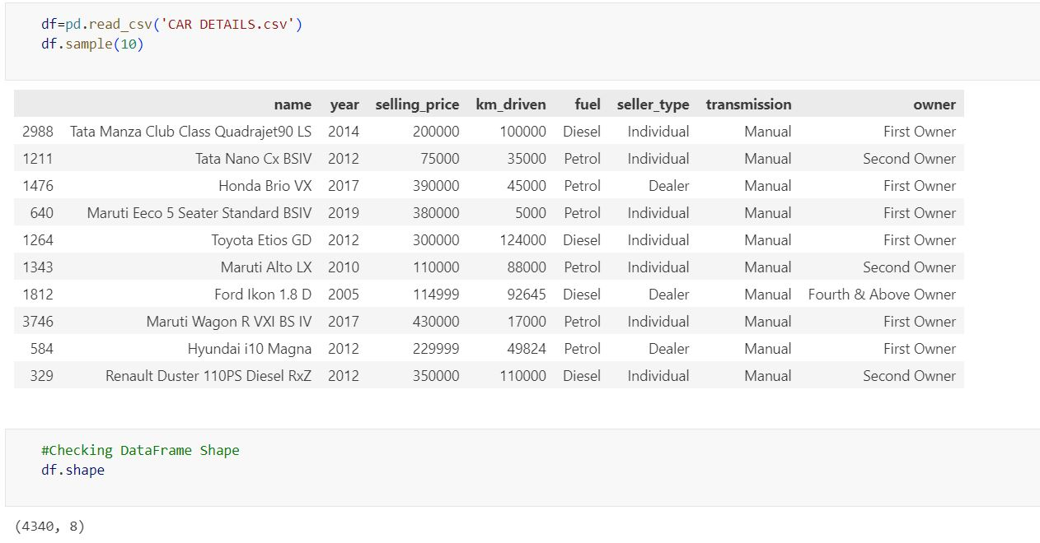
Analyzing Dataset

Slide 4
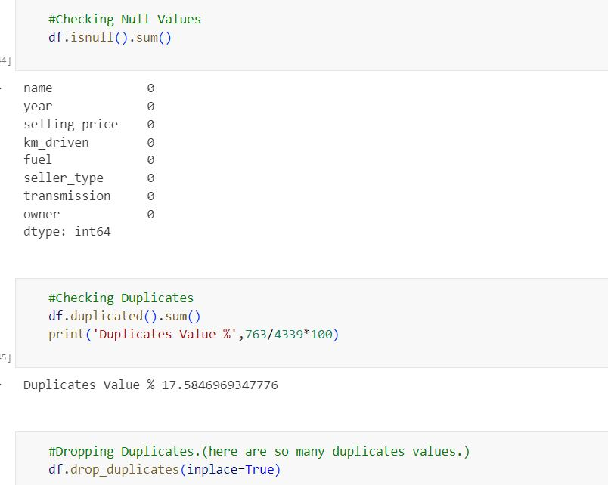
Handling Duplicates and Null Values

Slide 5
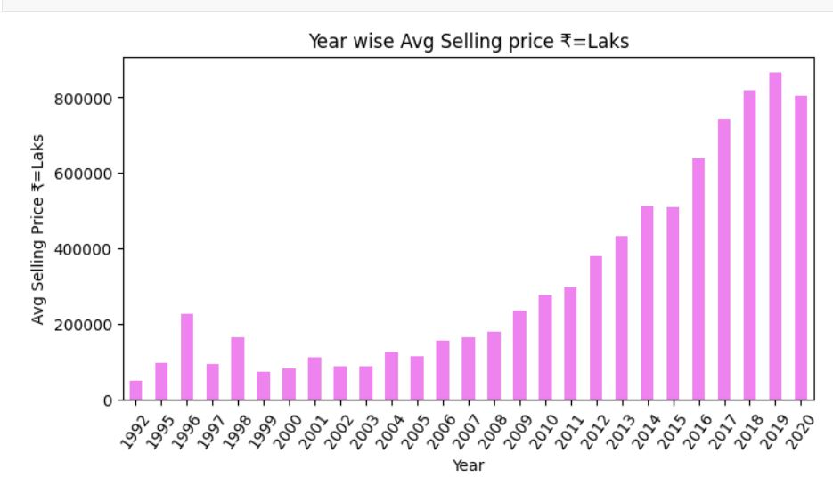
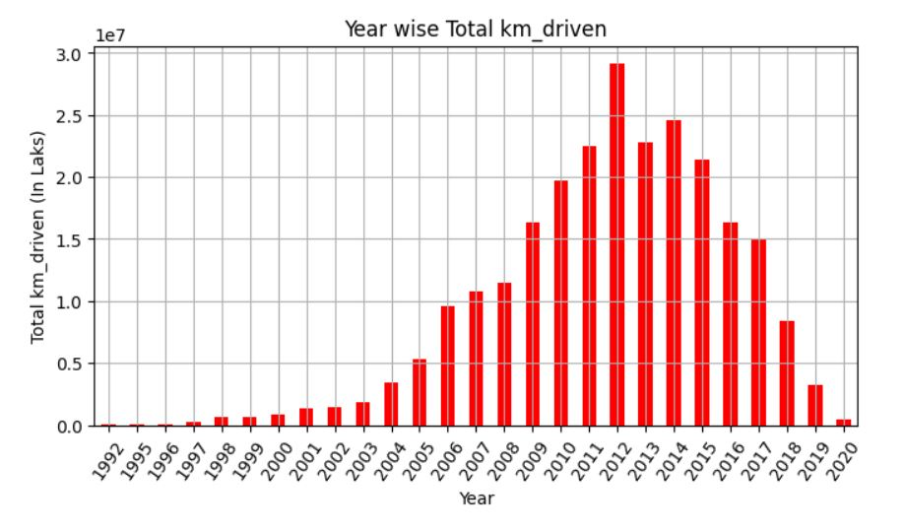
Inference: Here, we clearly see that over the years, the total kilometers driven by cars being resold vary. Before 2012, the usage was not as high, but it peaked in 2012. After that, the trend slowed down, and by 2020, cars arriving for resale had driven less than 50,000 kilometers.

Slide 6
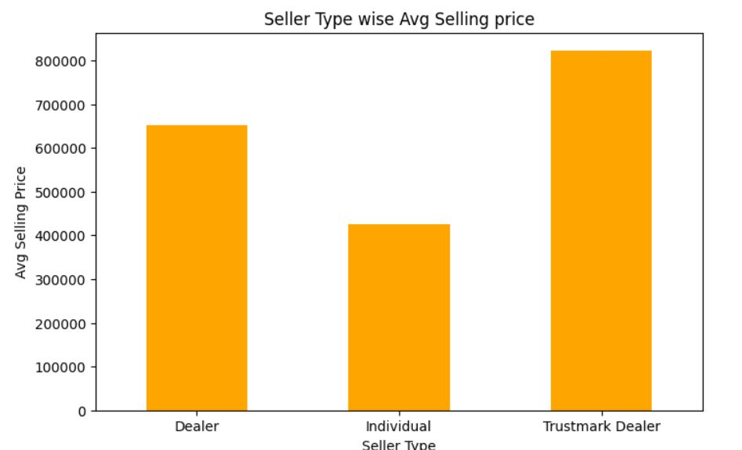
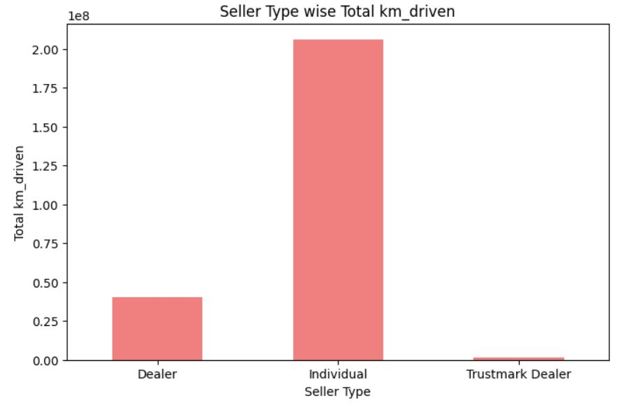
Inference: The selling price is higher in the Trustmaker Dealer category with a lower rate of distance driven by cars. Conversely, individual selling prices are lower when the kilometers driven are higher.

Slide 7
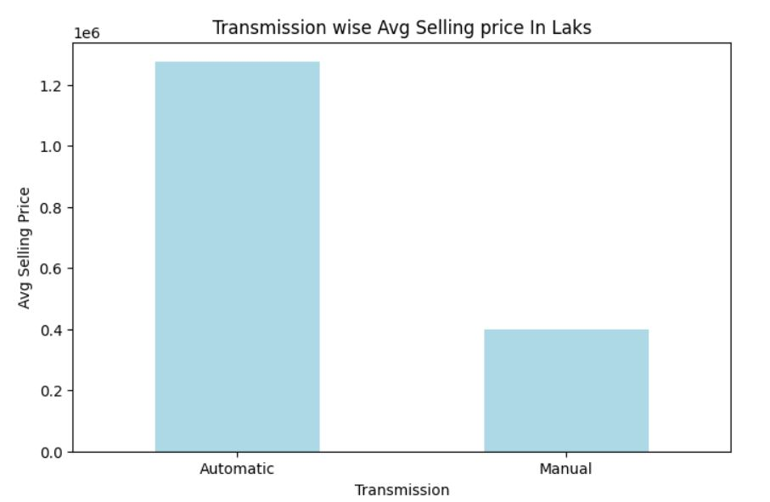
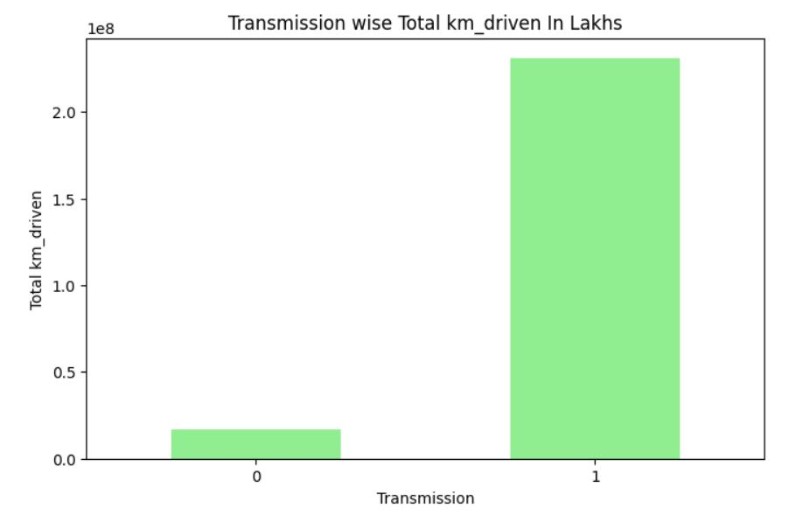
Inference: In the automatic transmission segment, prices are higher than in the manual vehicle segment. Conversely, automatic vehicles tend to be driven less compared to manual vehicles.

Slide 8
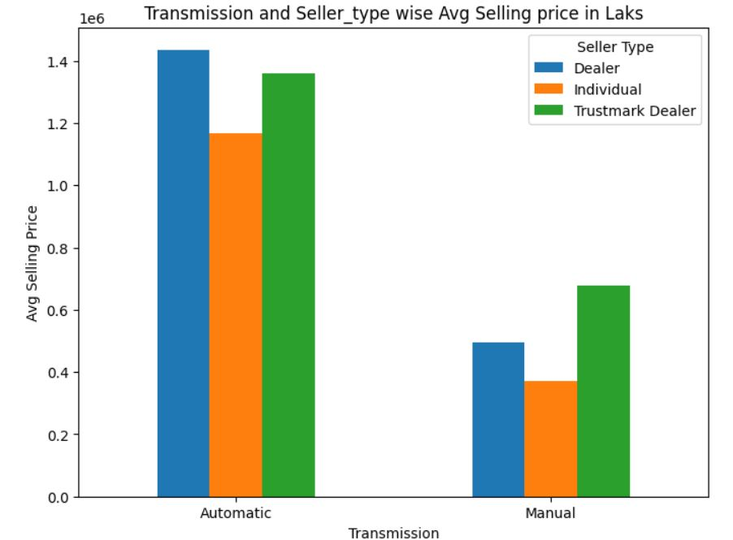
Inference: In the automatic segment, dealer prices are higher than those of Trustmark Dealers and individuals. However, in the manual segment, Trustmark Dealers have higher prices than the others.

Slide 9
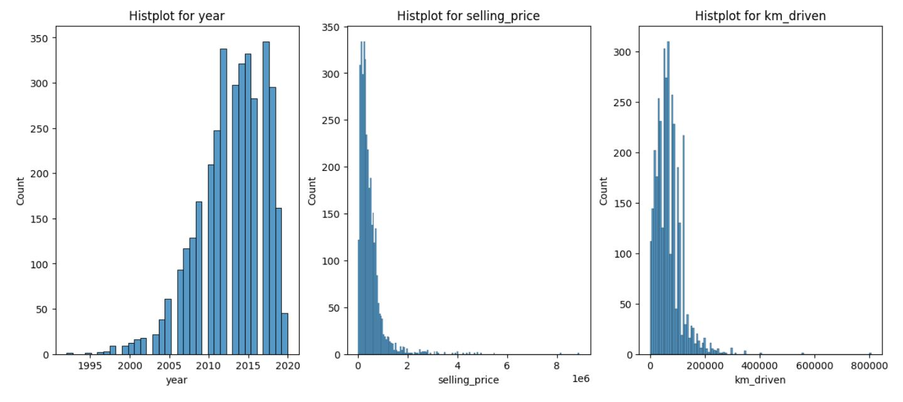
Inference: Examining patterns over the years reveals trends in used car prices, kilometers driven, and the quantity of cars available.

Slide 10
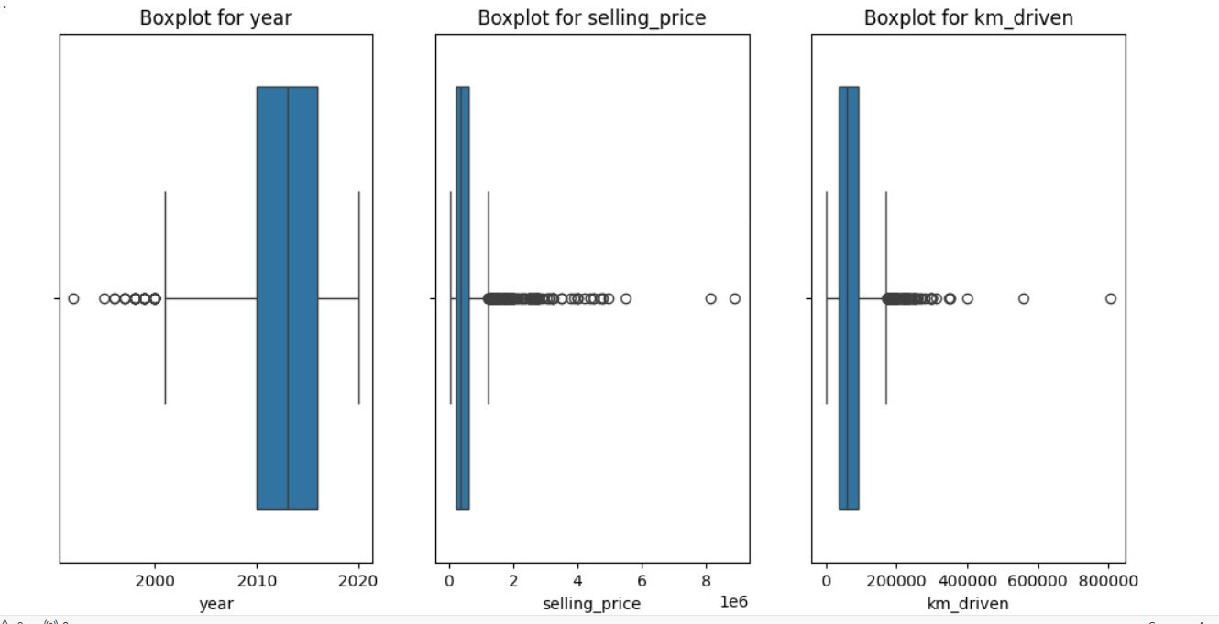
Outlier Detection And Tretment

Slide 11
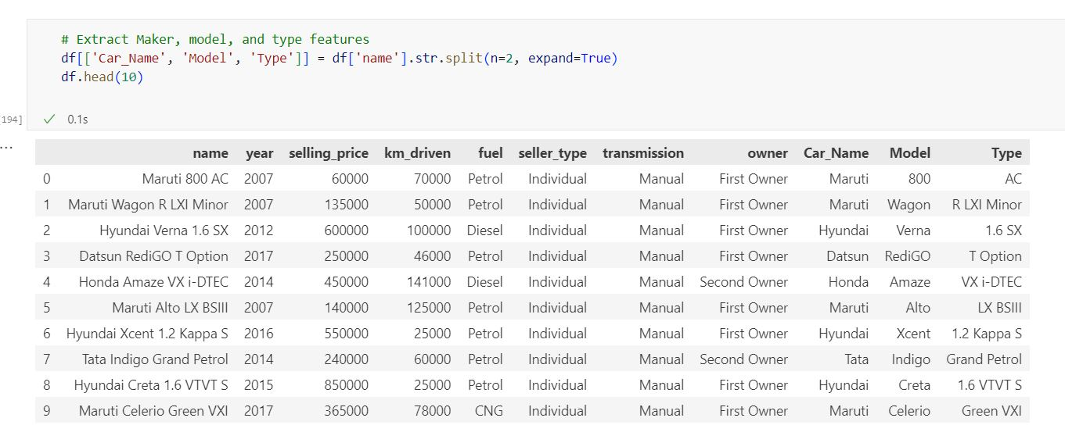
Extracting Important Features

Slide 12
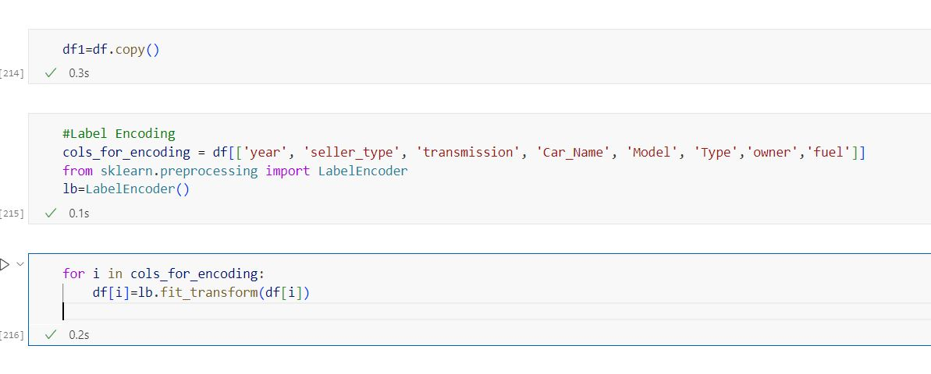
Label Encoding for Model Building

Slide 13
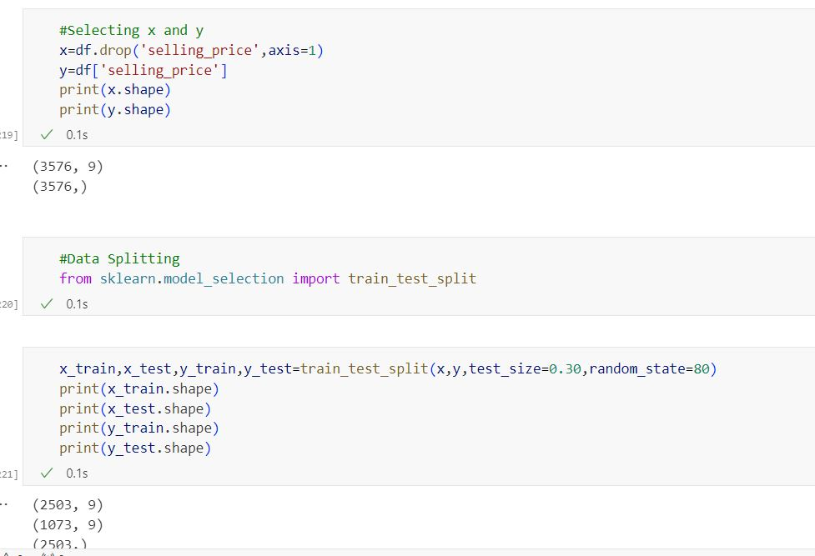
Selecting and Splitting Data

Slide 14
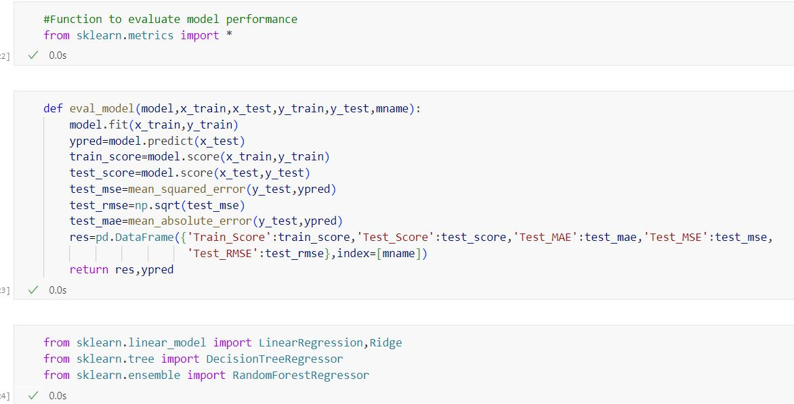
Creating eval Function & Model importing

Slide 15
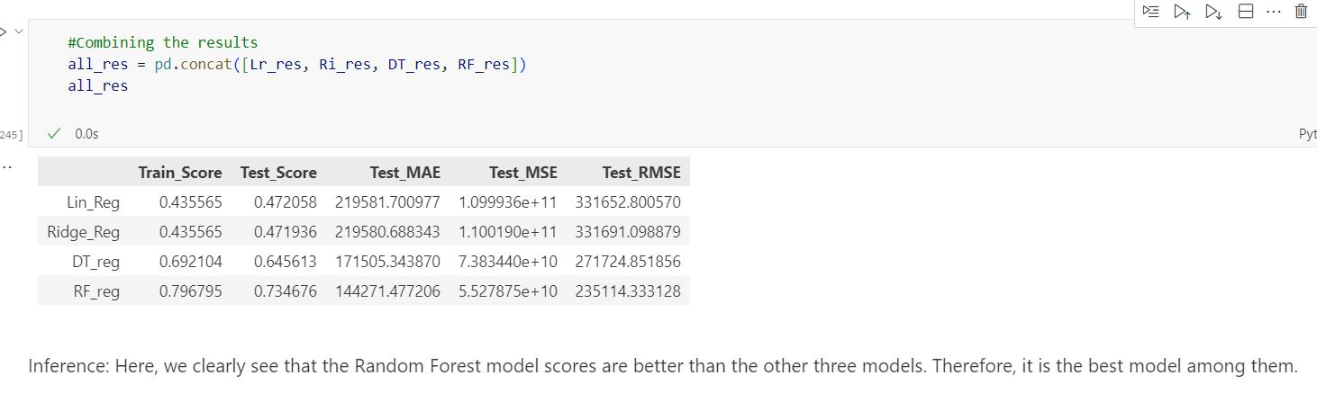
Model Comparison

Slide 16
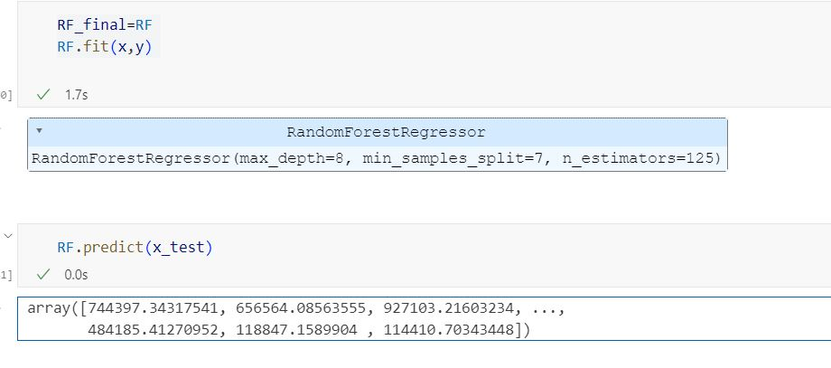
Finalizing Model

Slide 17
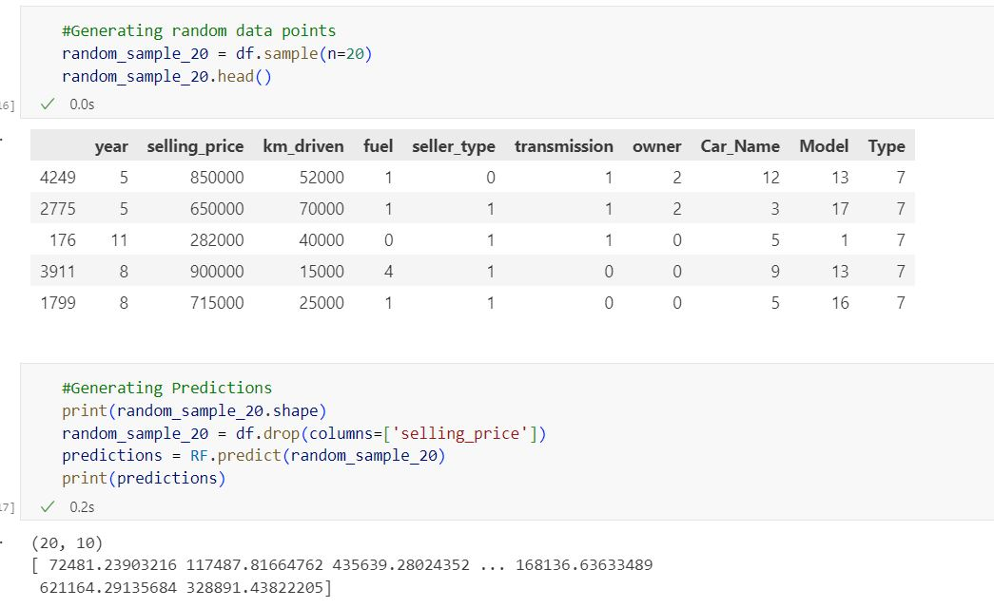
Generating Random Data Points and Model Testing

Slide 18
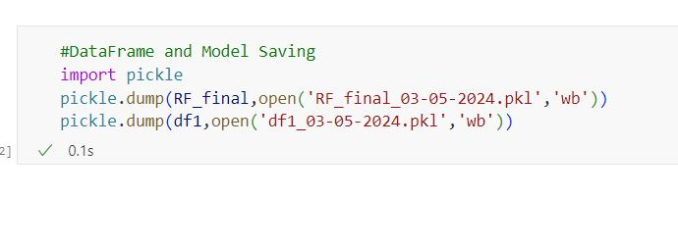
Loading Model

Slide 19
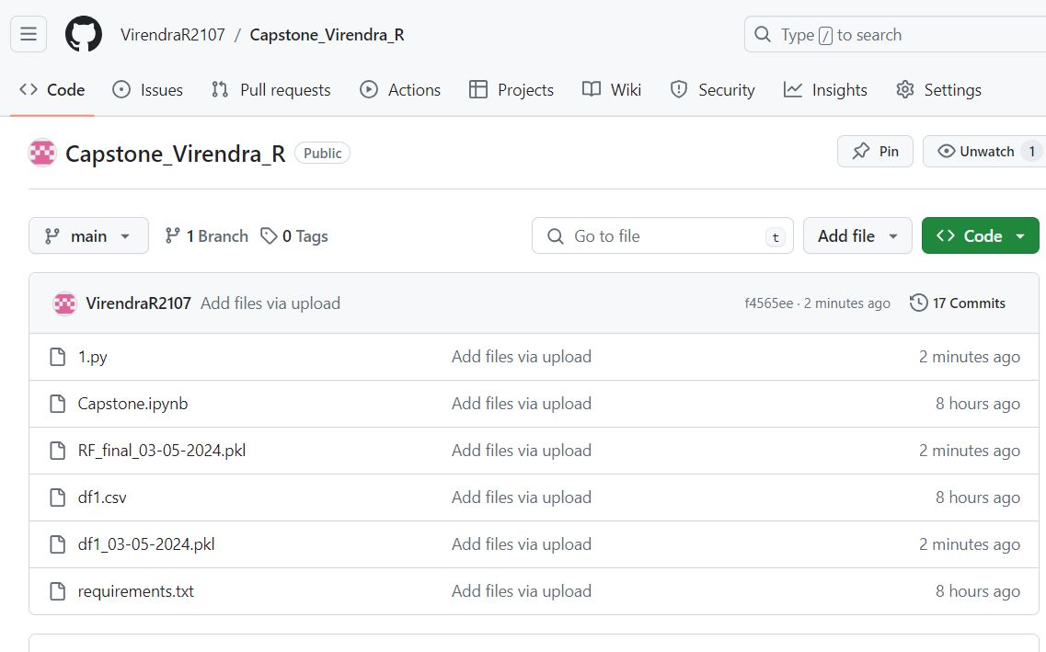
File Uploading inGithub Repo.

Slide 20
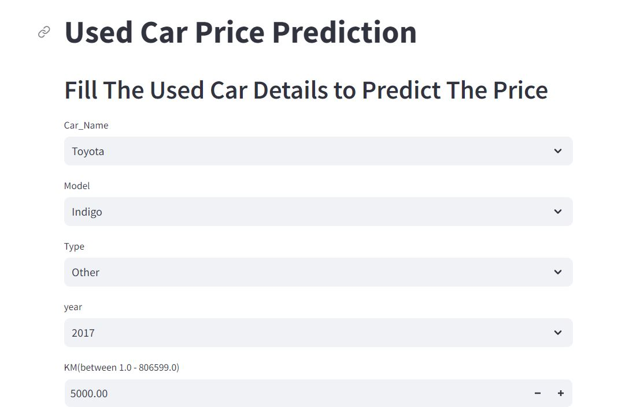
Streamlit App Interface Link:-Fill the used car details to predict the price

Slide 21

GitHub

